Slide 1

EUCLIDIAN TRANSFORMATION
BY
- MADHU PRASAD M

Slide 2
What is Geometric Transformation ?
Modify spatial relationship between pixels
Image can be shifted, Rotated, and Stretched in multiple ways

Slide 3
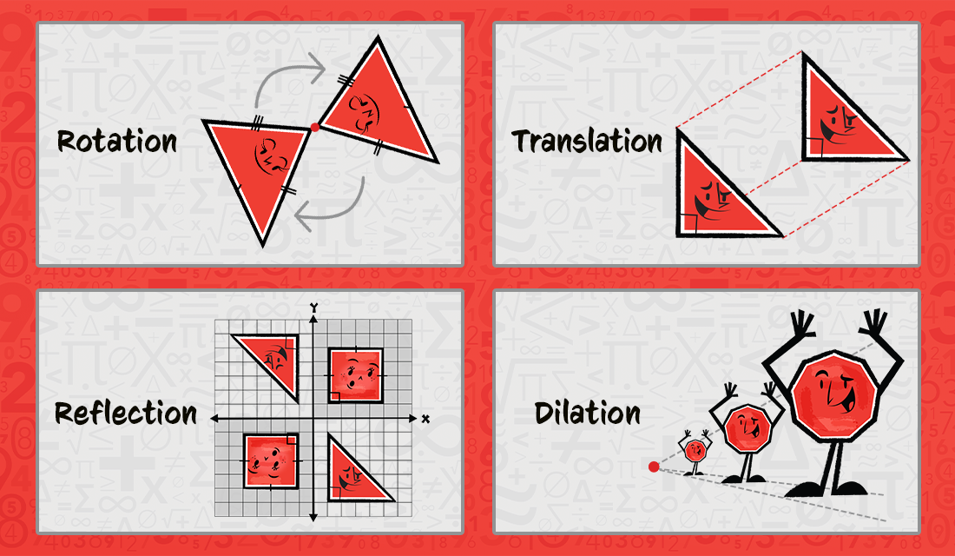
EXAMPLE

Slide 4
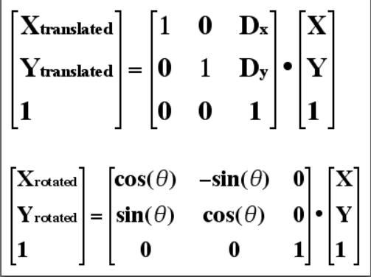
What is Euclidian or Isometric Transform?
Properties
. R is an orthogonal matrix
. Euclidian distance is preserved
. Has three degrees of freedom : two for translation and one for rotation

Slide 5
What is Euclidian or Isometric Transform?
Three Degrees of freedom
Theta – rotation we want to give
Tx = translation in x axis
Ty = translation in y axis

Slide 6
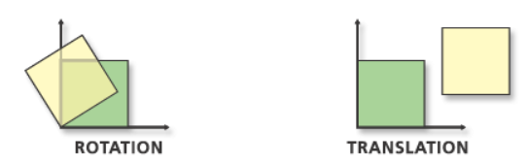
EXAMPLE

Slide 7
CHARACTERISTICS:
Distance remains preserved
Angles remained preserved
Shapes remain preserved

Slide 8
What is Affine Transform
Affine is generalization of Euclidian Transform
It has six degrees of freedom
Two for translation
One for rotation
One for scaling ratio
One for shearing
One for shearing direction
Paralled lines preserved but may be sheared
which means squares may be parallelograms.

Slide 9
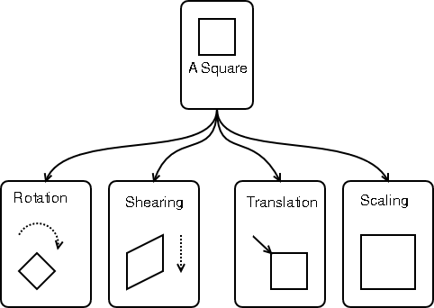
EXAMPLE

Slide 10
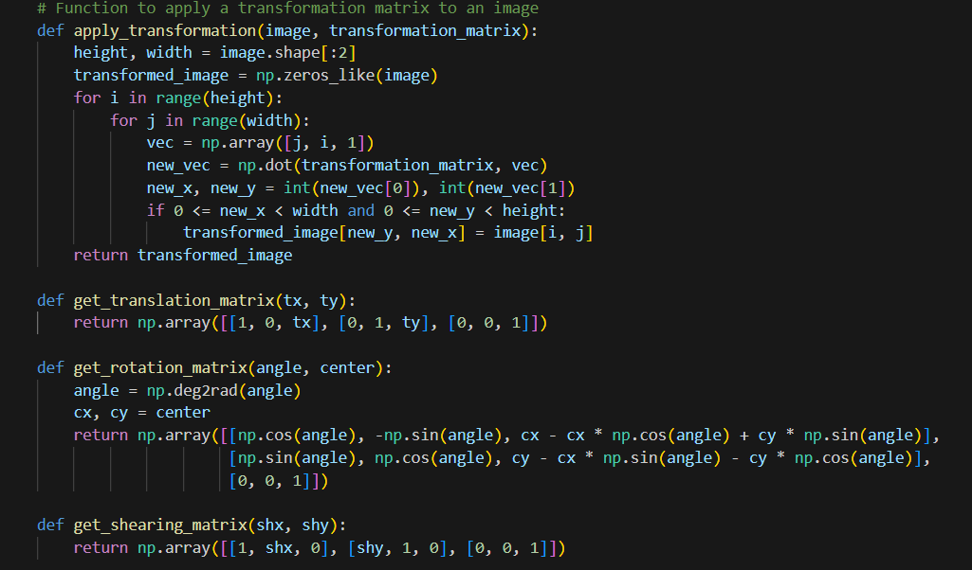
SAMPLE CODE

Slide 11
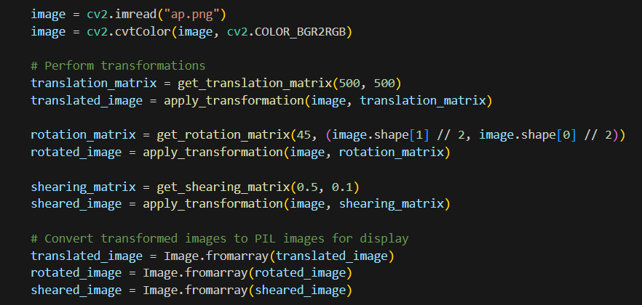
CONTINUED

Slide 12
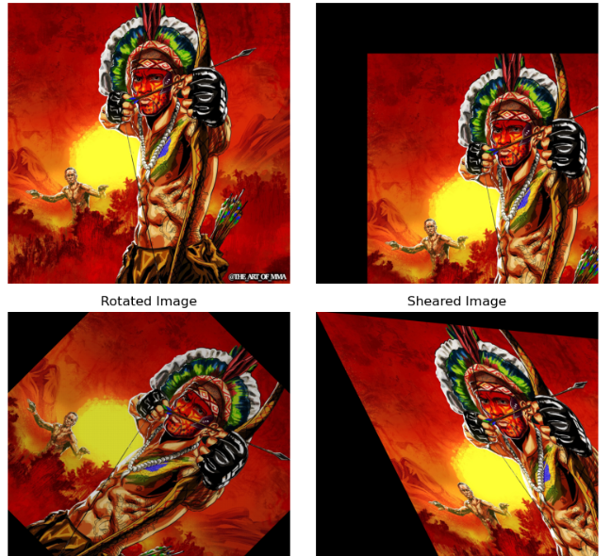
OUTPUT

